Slide 1
Taking Care of Business’s Awesome Final Project
Wag’s Corporation: Home of the Original Wag’s Gadget!

Slide 2
Wag’s Corporation Home Page ReadMe
Welcome to the Taking Care of Business’ take on the future Wag’s Corporation homepage. This is our first major project and in this presentation we will give a brief overview of the information that lovingly and pain-staking created site contains. Please enjoy!

Slide 3
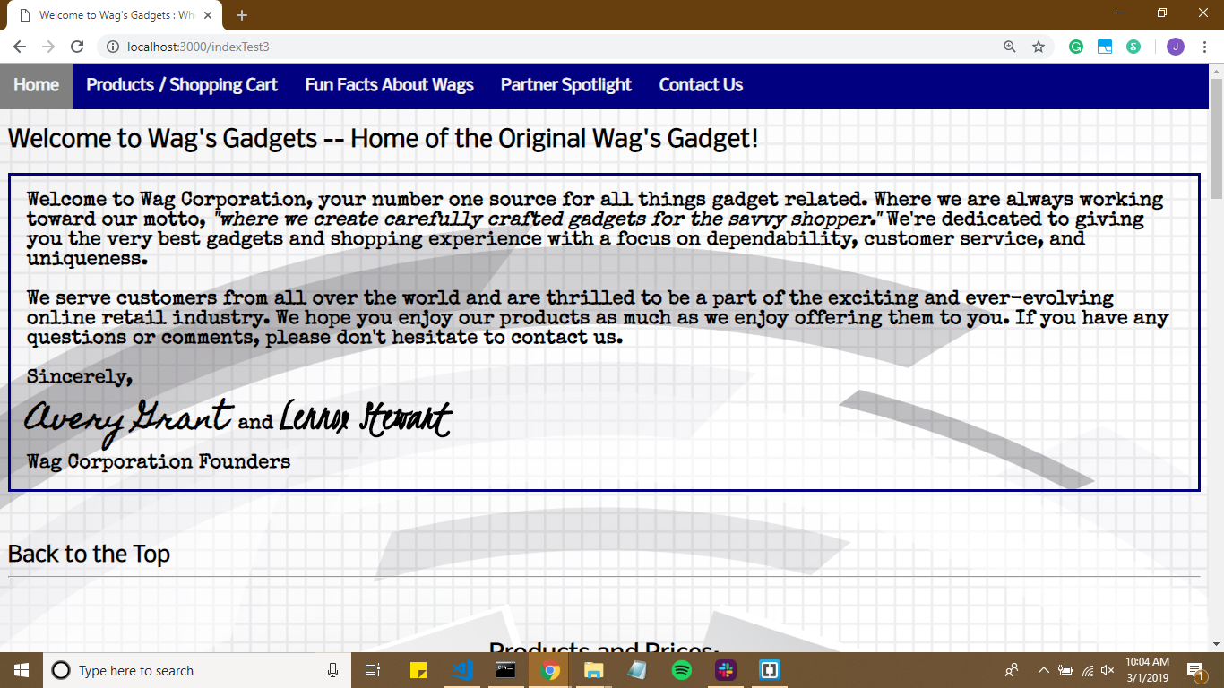
The Wag’s Home Page - Welcome Letter

Slide 4
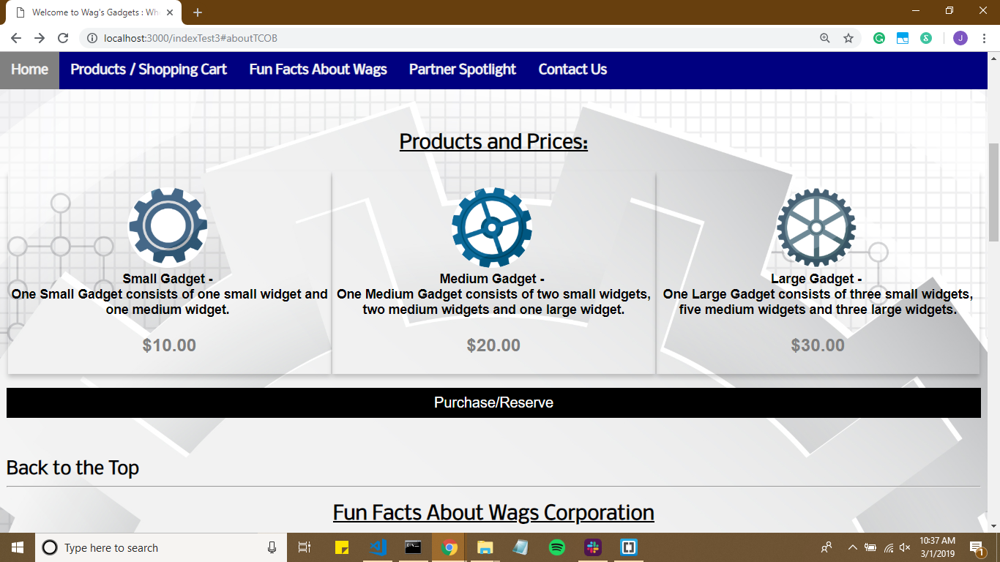
Wag’s Products and Pricing with link to Shopping Cart Page

Slide 5
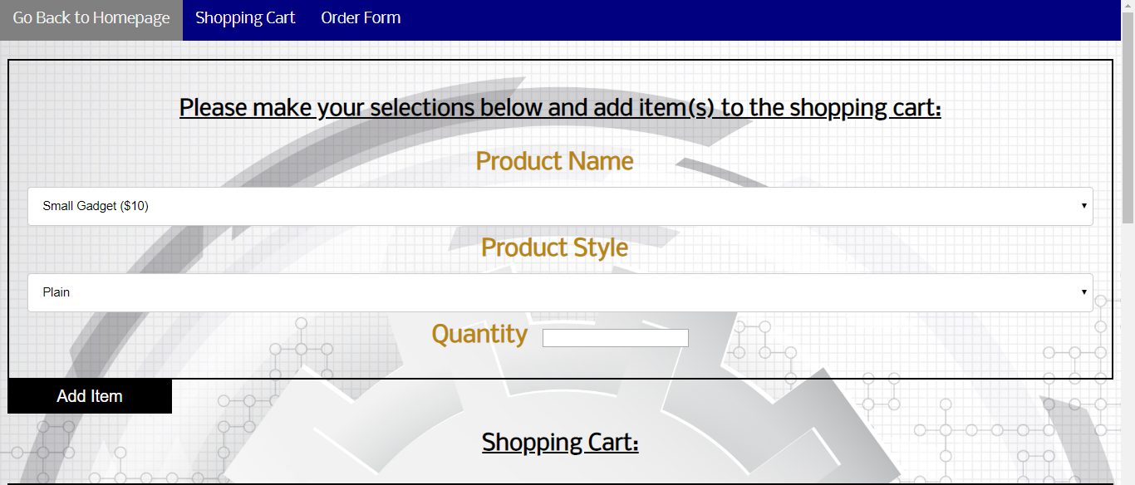
Shopping Cart /Order Page -- Customers can add or delete items they want then submit form (once the Purchase/Reserve Button is Pressed)

Slide 6
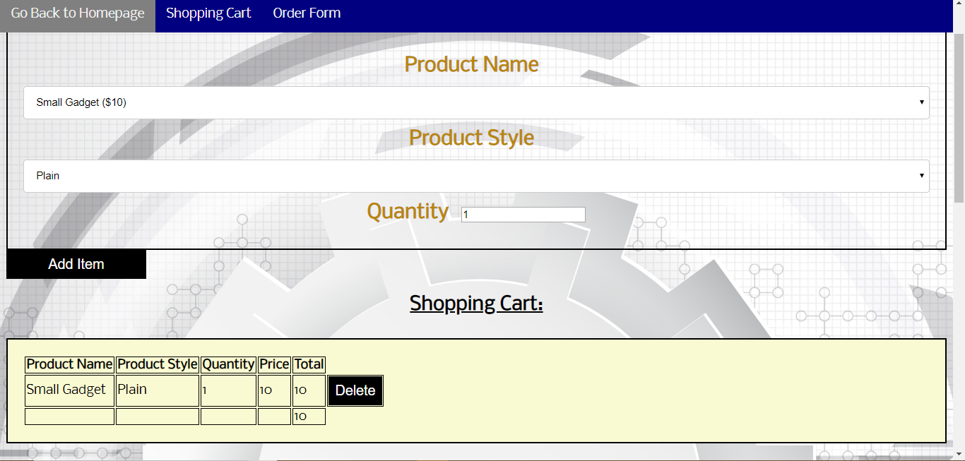
Shopping Cart Example -- Added Items

Slide 7
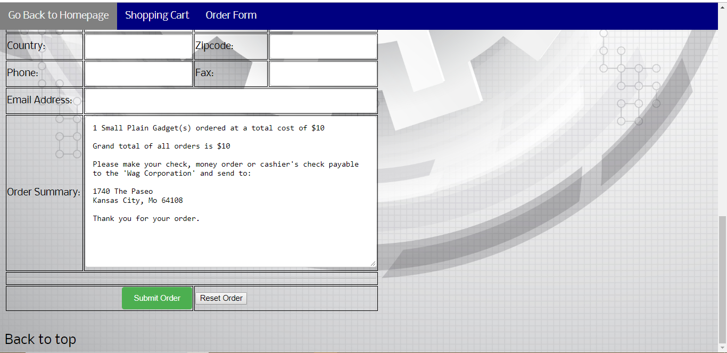
Order Summary when items are added

Slide 8
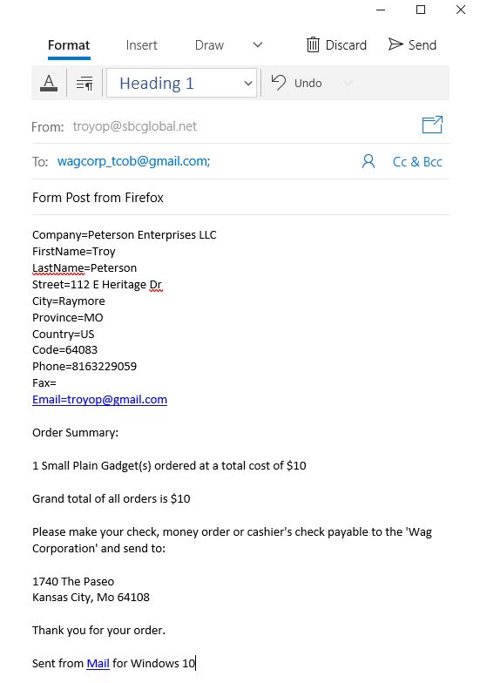
Order Submitted button generates an e-mail

Slide 9
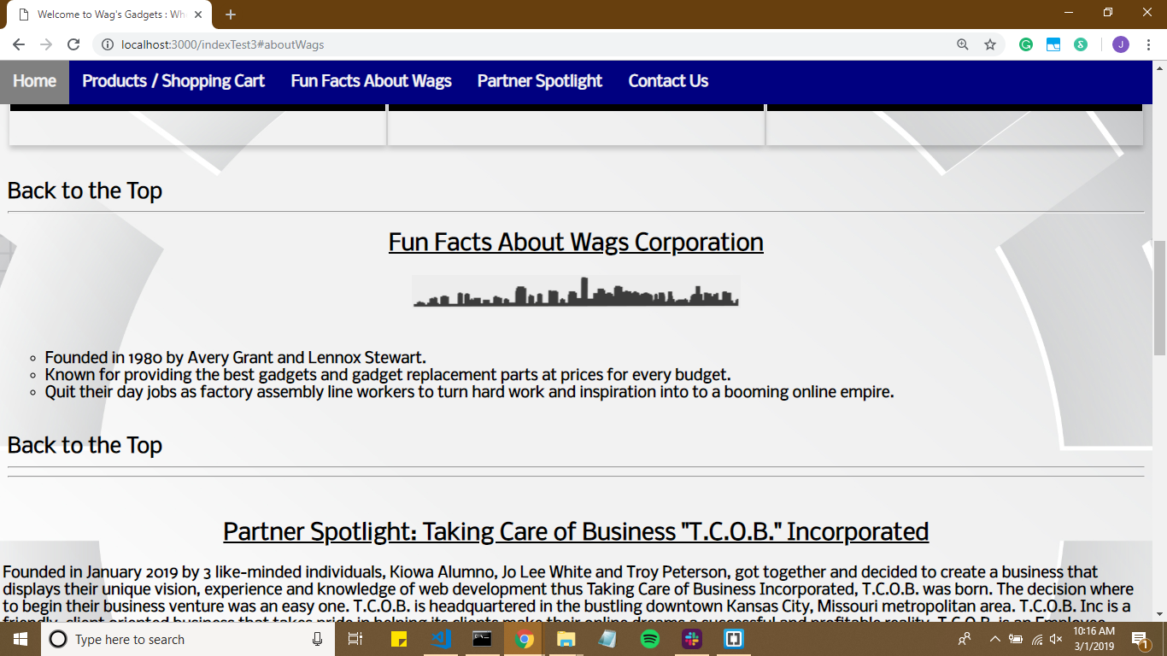
Fun Facts about Wag’s Corporation

Slide 10
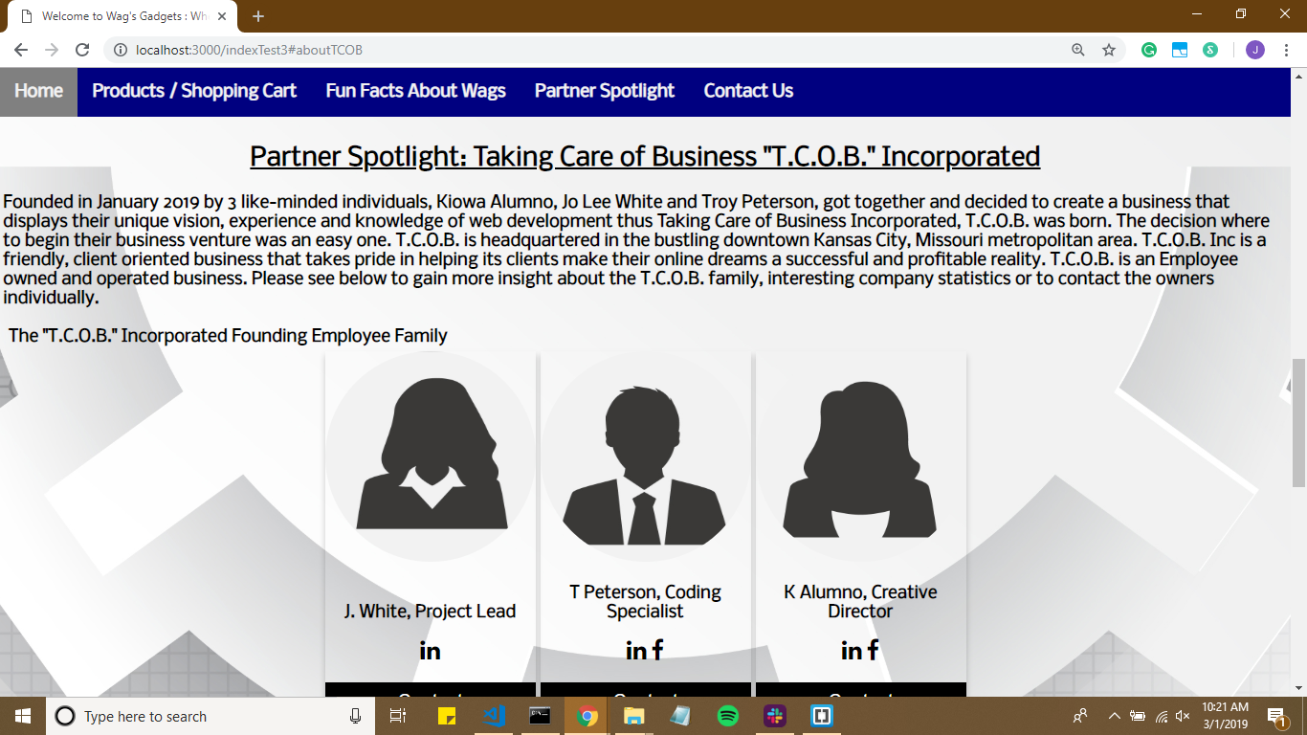
Partner Spotlight: "T.C.O.B." Incorporated -- Company Info and Employee Bios

Slide 11
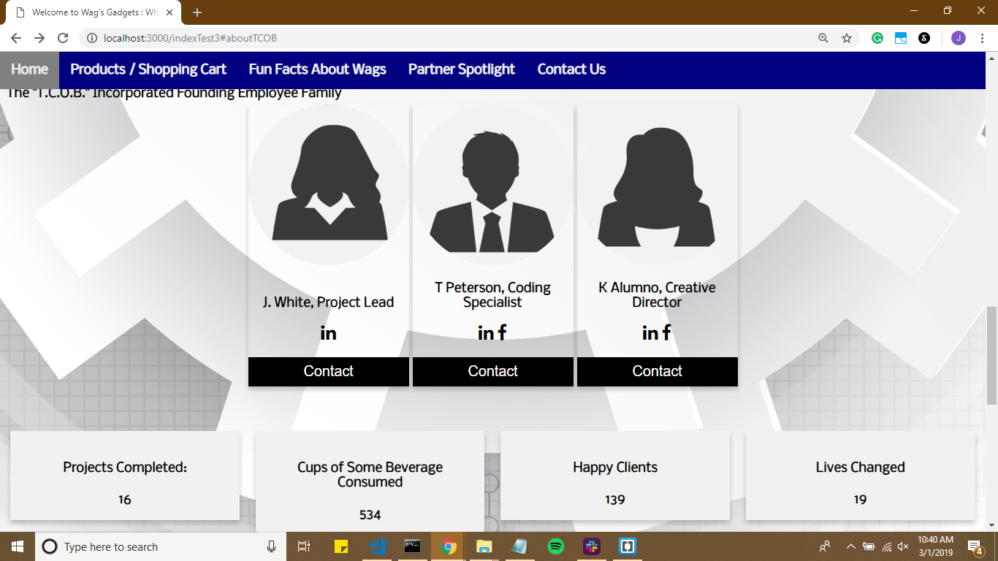
Partner Spotlight: "T.C.O.B." Incorporated -- Company Stat Information

Slide 12
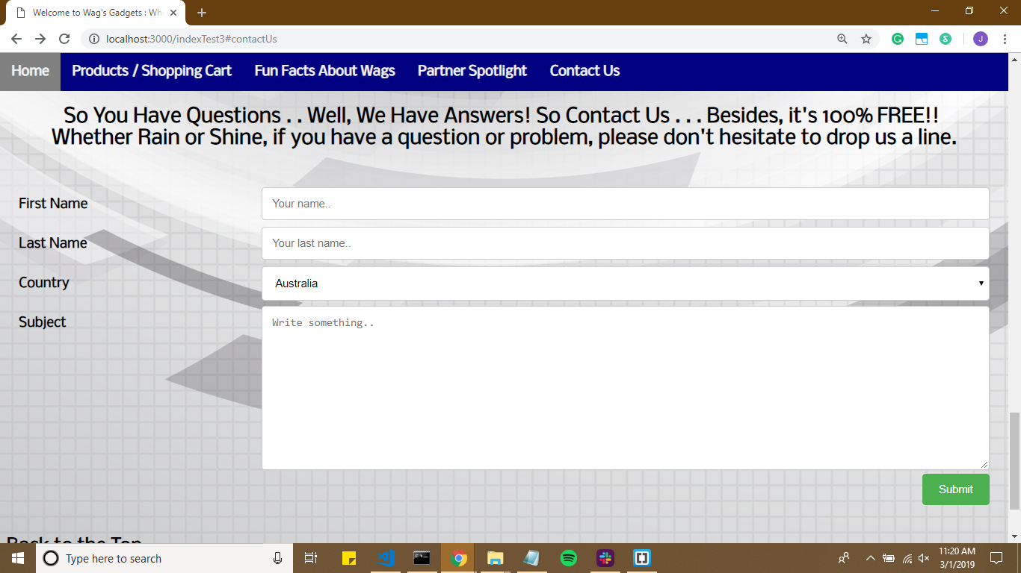
Contact Us -- Customers can send in questions or concerns

